Slide 1
Learning Objective
I will be able to determine expected value of continuous random variables
Success Criteria
At the end of the lesson, I will be able to:
4.2.2 Examine the concepts of a probability density function, cumulative distribution function, and probabilities associated with a continuous random variable given by integrals; examine simple types of continuous random variables and use them in appropriate contexts
4.2.3 Identify the expected value, variance and standard deviation of a continuous random variable and
evaluate them using technology

Slide 2
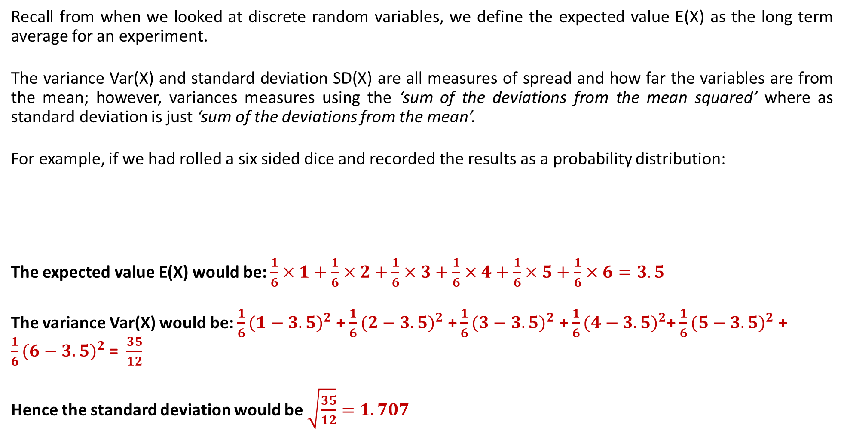
REVIEW: Expected Value, Variance and Standard Deviation for DRVs
Recall from when we looked at discrete random variables, we define the expected value E(X) as the long term average for an experiment.
The variance Var(X) and standard deviation SD(X) are all measures of spread and how far the variables are from the mean; however, variances measures using the ‘sum of the deviations from the mean squared’ where as standard deviation is just ‘sum of the deviations from the mean’.
For example, if we had rolled a six sided dice and recorded the results as a probability distribution:
The expected value E(X) would be: $\frac{1}{6}×1+\frac{1}{6}×2+\frac{1}{6}×3+\frac{1}{6}×4+\frac{1}{6}×5+\frac{1}{6}×6=3.5$
The variance Var(X) would be: $\frac{1}{6}(1−3.5)^{2}$ + $\frac{1}{6}(2−3.5)^{2}$ + $\frac{1}{6}(3−3.5)^{2}$ + $\frac{1}{6}(4−3.5)^{2}$+ $\frac{1}{6}(5−3.5)^{2}$ + $\frac{1}{6}(6−3.5)^{2}$ = $\frac{35}{12}$
Hence the standard deviation would be $\sqrt{\frac{35}{12}}=1.707$
x | 1 | 2 | 3 | 4 | 5 | 6
P(X = x) | $$\frac{1}{6}$$ | $$\frac{1}{6}$$ | $$\frac{1}{6}$$ | $$\frac{1}{6}$$ | $$\frac{1}{6}$$ | $$\frac{1}{6}$$

Slide 3
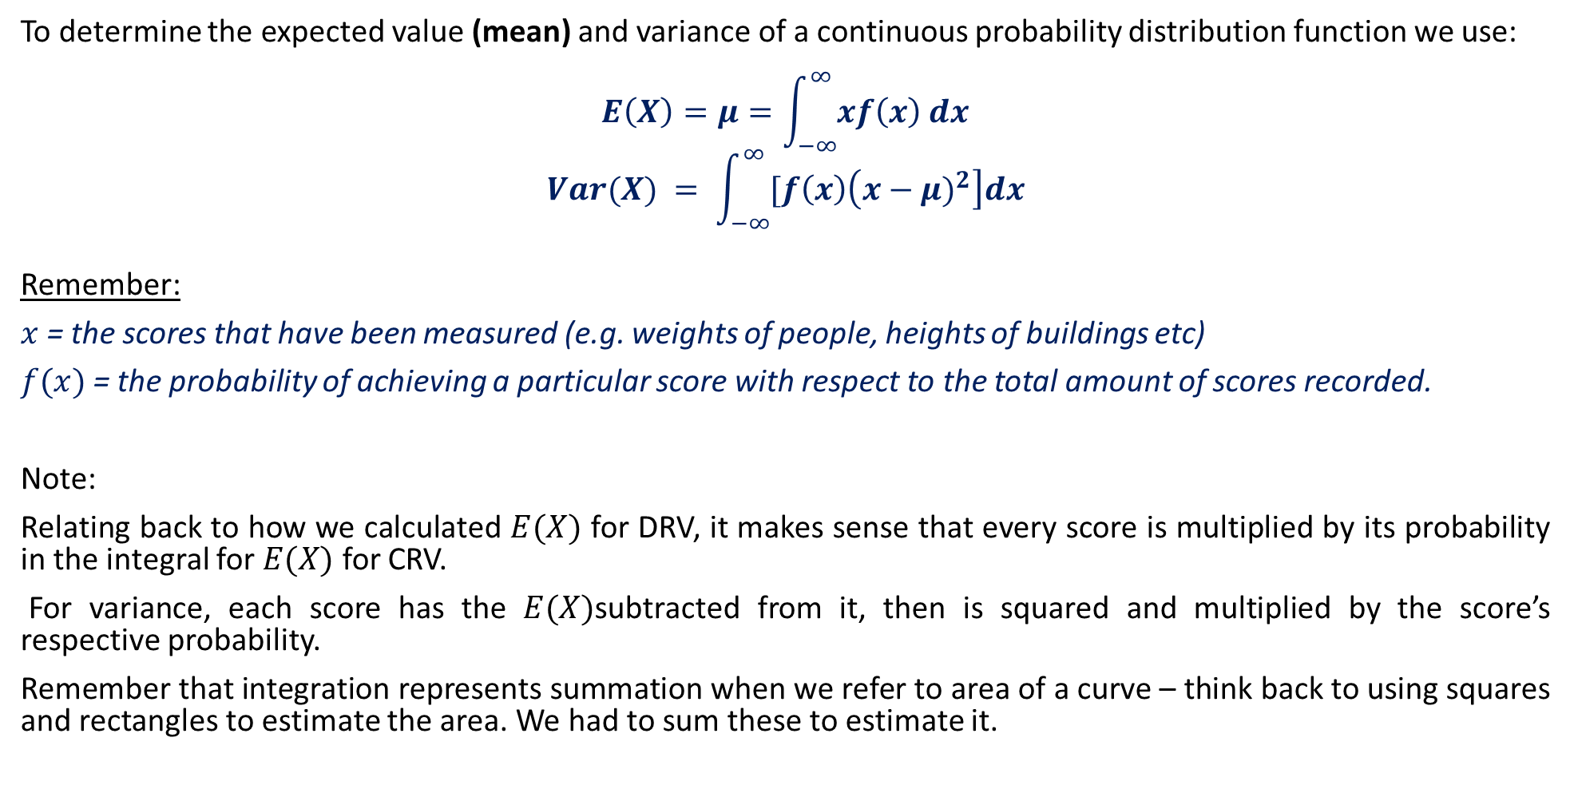
Expected Value, Variance and Standard Deviation for CRVs
To determine the expected value (mean) and variance of a continuous probability distribution function we use:
$$E\left(X\right)=μ=\int_{−∞}^{∞}{xf\left(x\right) dx}$$
$$Var(X) = \int_{−∞}^{∞}{[f\left(x\right)\left(x−μ)^{2}\right]dx}$$
Remember:
$x$= the scores that have been measured (e.g. weights of people, heights of buildings etc)
$f(x)$= the probability of achieving a particular score with respect to the total amount of scores recorded.
Note:
Relating back to how we calculated $E(X)$ for DRV, it makes sense that every score is multiplied by its probability in the integral for $E(X)$ for CRV.
For variance, each score has the $E(X)$subtracted from it, then is squared and multiplied by the score’s respective probability.
Remember that integration represents summation when we refer to area of a curve – think back to using squares and rectangles to estimate the area. We had to sum these to estimate it.

Slide 4
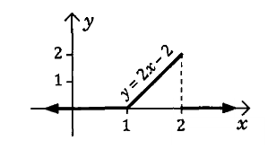
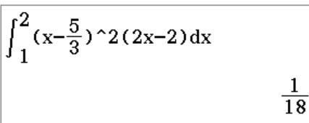
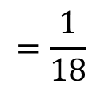
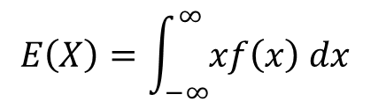
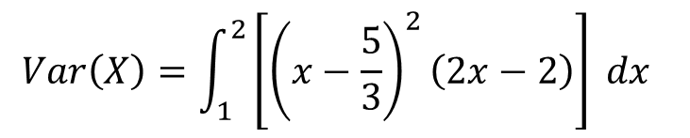
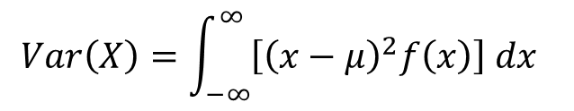
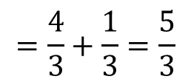
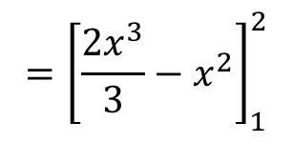
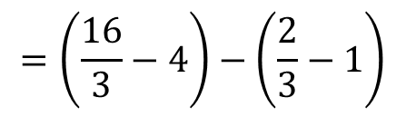
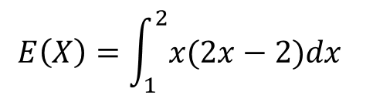
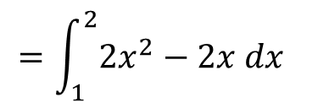
Guided Practice
Determine the expected value and variance for the following probability distribution function.
$$E\left(X\right)=\int_{−∞}^{∞}{xf\left(x\right) dx}$$
$$Var\left(X\right)=\int_{−∞}^{∞}{\left[{\left(x−μ\right)}^{2}f\left(x\right)\right] dx}$$
$$E\left(X\right)=\int_{1}^{2}{x(2x−2)dx}$$
$$Var\left(X\right)=\int_{1}^{2}{\left[{\left(x−\frac{5}{3}\right)}^{2}\left(2x−2\right)\right] dx}$$
$$=\int_{1}^{2}{2x^{2}−2x dx}$$
$$=\frac{1}{18}$$
$$={\left[\frac{2x^{3}}{3}−x^{2}\right]}_{1}^{2}$$
$$=\left(\frac{16}{3}−4\right)−\left(\frac{2}{3}−1\right)$$
$$=\frac{4}{3}+\frac{1}{3}=\frac{5}{3}$$

Slide 5
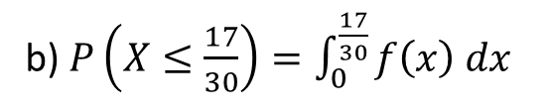

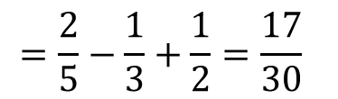
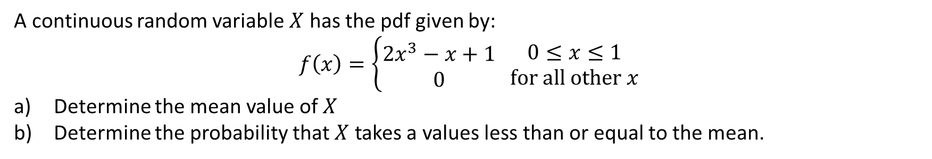
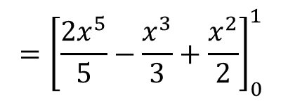

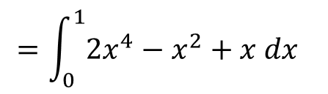
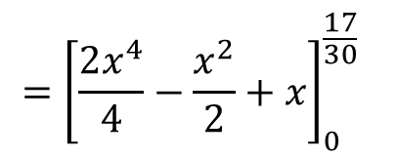
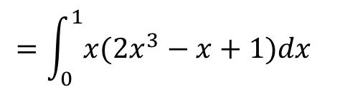
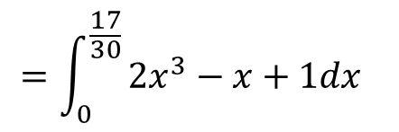
Guided Practice
A continuous random variable $X$ has the pdf given by:
$$f\left(x\right)=\left\{\begin{aligned}2x^{3}−x+1 \\ 0\end{aligned} \begin{matrix}0≤x≤1 \\ for all other x\end{matrix}\right.$$
Determine the mean value of $X$
Determine the probability that $X$ takes a values less than or equal to the mean.
a) $μ=E\left(X\right)=\int_{0}^{1}{xf\left(x\right) dx}$
b) $P\left(X≤\frac{17}{30}\right)=\int_{0}^{\frac{17}{30}}{f\left(x\right) dx}$
$$=\int_{0}^{1}{x({2x}^{3}−x+1)dx}$$
$$=\int_{0}^{\frac{17}{30}}{{2x}^{3}−x+1dx}$$
$$=\int_{0}^{1}{2x^{4}−x^{2}+x dx}$$
$$={\left[\frac{2x^{4}}{4}−\frac{x^{2}}{2}+x\right]}_{0}^{\frac{17}{30}}$$
$$={\left[\frac{2x^{5}}{5}−\frac{x^{3}}{3}+\frac{x^{2}}{2}\right]}_{0}^{1}$$
$$≈0.4577$$
$$=\frac{2}{5}−\frac{1}{3}+\frac{1}{2}=\frac{17}{30}$$

Slide 6
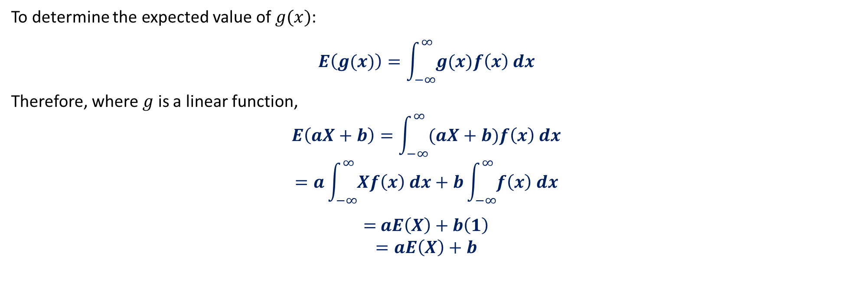

Expected Value of $g(x)$
To determine the expected value of $g(x)$:
$$E\left(g(x)\right)=\int_{−∞}^{∞}{g(x)f\left(x\right) dx}$$
Therefore, where $g$ is a linear function,
$$E\left(aX+b\right)=\int_{−∞}^{∞}{(aX+b)f\left(x\right) dx}$$
$$=a\int_{−∞}^{∞}{Xf\left(x\right) dx}+b\int_{−∞}^{∞}{f\left(x\right) dx}$$
$=$ $aE\left(X\right)+b\left(1\right)$
$$=aE\left(X\right)+b$$

Slide 7
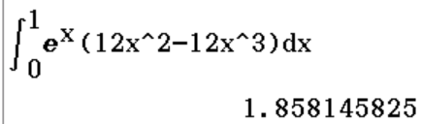

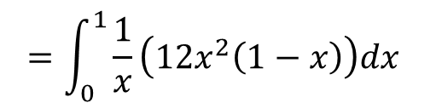


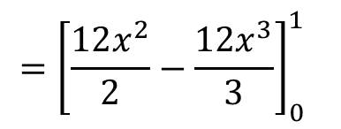

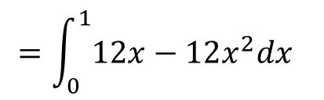
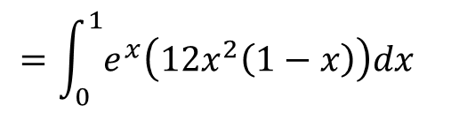
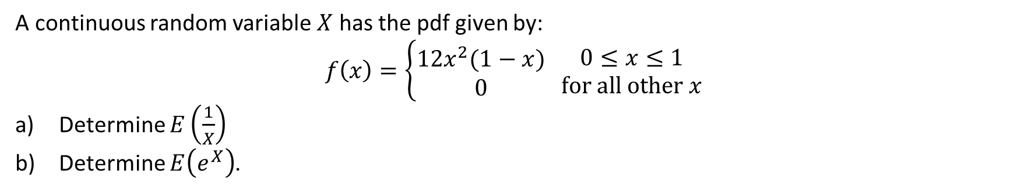

Guided Practice
A continuous random variable $X$ has the pdf given by:
$$f\left(x\right)=\left\{\begin{aligned}12x^{2}(1−x) \\ 0\end{aligned} \begin{matrix}0≤x≤1 \\ for all other x\end{matrix}\right.$$
Determine $E\left(\frac{1}{X}\right)$
Determine $E\left(e^{X}\right)$.
a) $E\left(\frac{1}{X}\right)=\int_{0}^{1}{\frac{1}{x}f\left(x\right) dx}$
b) $E\left(e^{x}\right)=\int_{0}^{1}{e^{x}f\left(x\right) dx}$
$$=\int_{0}^{1}{\frac{1}{x}\left(12x^{2}\left(1−x\right)\right)dx}$$
$$=\int_{0}^{1}{e^{x}\left(12x^{2}\left(1−x\right)\right)dx}$$
$$=\int_{0}^{1}{12x−12x^{2}dx}$$
$$≈1.858$$
$$={\left[\frac{12x^{2}}{2}−\frac{{12x}^{3}}{3}\right]}_{0}^{1}$$
$$={\left[6x^{2}−4x^{3}\right]}_{0}^{1}$$
$$=6\left(1\right)−4\left(1\right)−0=2$$

Slide 8
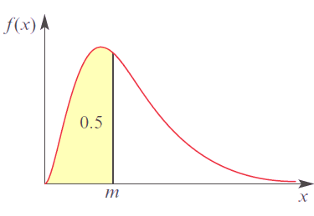
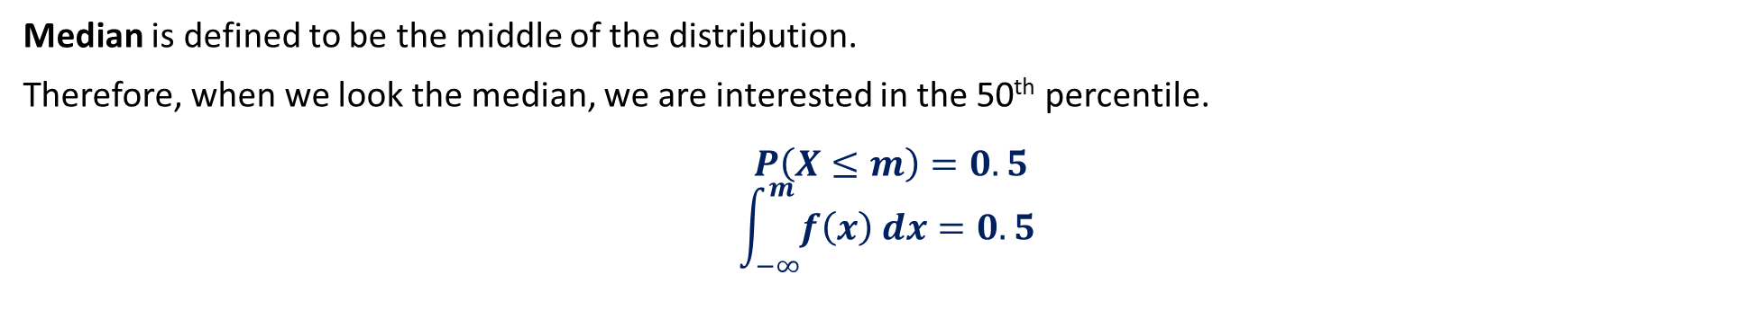


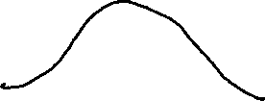
Median of CRV
In later chapters, we will be interested in another measure known as percentile.
Example: What is the mark $p$ which $75\%$ students fall in.
$$P\left(X≤p\right)=\int_{−∞}^{p}{f\left(x\right) dx}=q$$
In this case, we will substitute $q=0.75.$
Median is defined to be the middle of the distribution.
Therefore, when we look the median, we are interested in the 50th percentile.
$$P\left(X≤m\right)=0.5$$
$$\int_{−∞}^{m}{f\left(x\right) dx}=0.5$$

Slide 9
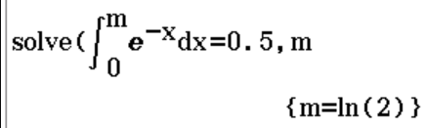




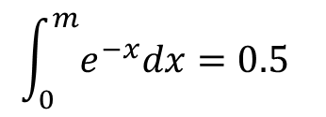


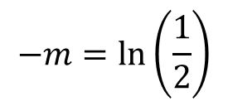





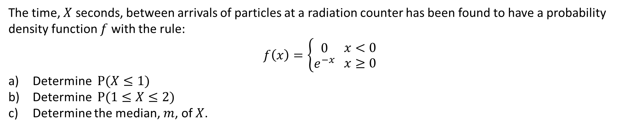


Guided Practice
The time, $X$ seconds, between arrivals of particles at a radiation counter has been found to have a probability density function $f$ with the rule:
$$f\left(x\right)=\left\{\begin{aligned}0 \\ e^{−x}\end{aligned} \begin{matrix}x<0 \\ x≥0\end{matrix}\right.$$
Determine $P(X≤1)$
Determine $P(1≤X≤2)$
Determine the median, $m$, of $X$.
a) $P\left(X≤1\right)=\int_{0}^{1}{e^{−x}dx}$
b) $P\left(1≤X≤2\right)=\int_{1}^{2}{e^{−x}dx}$
c) $P\left(X≤m\right)=0.5$
$$={\left[−e^{−x}\right]}_{0}^{1}$$
$$={\left[−e^{−x}\right]}_{1}^{2}$$
$$\int_{0}^{m}{e^{−x}dx}=0.5$$
$$=−e^{−1}+1$$
$$=−e^{−2}+e^{−1}$$
$$≈0.632 (3 d.p.)$$
$$≈0.233 (3 d.p.)$$
$${\left[−e^{−x}\right]}_{0}^{m}=0.5$$
$$−e^{−m}+1=0.5$$
$$e^{−m}=0.5$$
$$−m=\ln\left(\frac{1}{2}\right)$$
$$m=\ln\left(2\right)$$

Slide 10


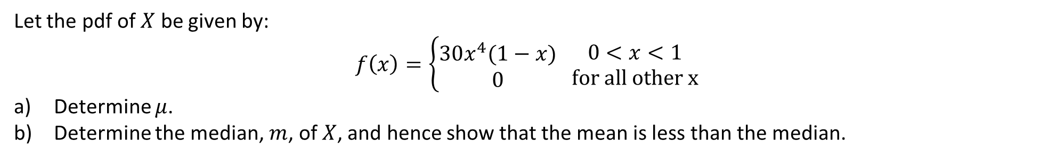
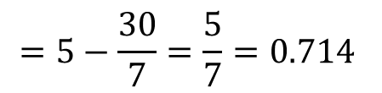
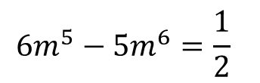
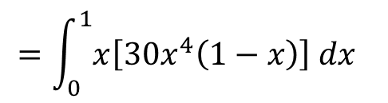
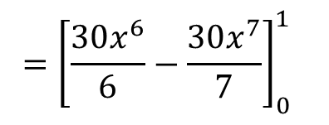
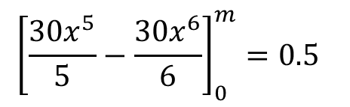
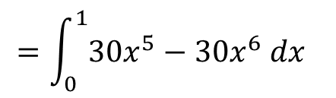

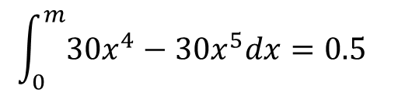

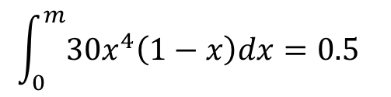

Guided Practice
Let the pdf of $X$ be given by:
$$f\left(x\right)=\left\{\begin{aligned}30x^{4}(1−x) \\ 0\end{aligned} \begin{matrix}0<x<1 \\ for all other x\end{matrix}\right.$$
Determine $μ$.
Determine the median, $m$, of $X$, and hence show that the mean is less than the median.
$$m=0.736, m=1.150$$
a) $μ=E\left(x\right)=\int_{0}^{1}{xf\left(x\right) dx}$
b) $P\left(X≤m\right)=0.5$
Reject $m=1.150$ as $x<1$
$$=\int_{0}^{1}{x\left[30x^{4}\left(1−x\right)\right] dx}$$
$$\int_{0}^{m}{30x^{4}\left(1−x\right)dx}=0.5$$
$∴$ median, $m=0.736>μ=0.714$
$$=\int_{0}^{1}{30x^{5}−30x^{6} dx}$$
$$\int_{0}^{m}{30x^{4}−30x^{5}dx}=0.5$$
Hence mean is less than the median.
$$={\left[\frac{30x^{6}}{6}−\frac{30x^{7}}{7}\right]}_{0}^{1}$$
$${\left[\frac{30x^{5}}{5}−\frac{30x^{6}}{6}\right]}_{0}^{m}=0.5$$
$$=5−\frac{30}{7}=\frac{5}{7}=0.714$$
$$6m^{5}−5m^{6}=\frac{1}{2}$$

Slide 11

Variance and Standard Deviation for CRVs
To find variance of a continuous probability distribution function, we use:
$$Var\left(X\right)= \int_{−∞}^{∞}{[f\left(x\right)\left(x−μ)^{2}\right]dx}$$
Standard deviation of a continuous probability distribution function is thus:
$$sd\left(X\right)=\sqrt{Var\left(x\right)}$$
Note
The alternative of $Var\left(X\right)=E\left(X^{2}\right)−μ^{2}$
BUT it is not part of the SCSA syllabus.

Slide 12
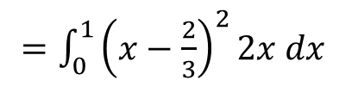

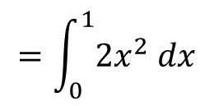
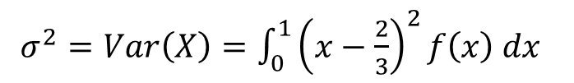



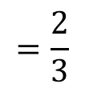
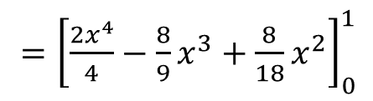






Guided Practice
Let the pdf of $X$ be given by:
$$f\left(x\right)=\left\{\begin{aligned}2x \\ 0\end{aligned} \begin{matrix}0<x<1 \\ for all other x\end{matrix}\right.$$
Determine the variance of $X$.
Hence, find the standard deviation of $X$.
a) $μ=E\left(X\right)=\int_{0}^{1}{xf\left(x\right) dx}$
$σ^{2}=Var\left(X\right)=\int_{0}^{1}{{\left(x−\frac{2}{3}\right)}^{2}f\left(x\right) dx}$
b) $σ^{ }=\sqrt{Var(x)}$
$=\int_{0}^{1}{{\left(x−\frac{2}{3}\right)}^{2}2x dx}$
$=\sqrt{\frac{1}{18}}$
$$=\int_{0}^{1}{2x^{2} dx}$$
$=\int_{0}^{1}{2x\left(x^{2}−\frac{4}{3}x+\frac{4}{9}\right) dx}$
$=\frac{1}{3\sqrt{2}}$
$$={\left[\frac{2x^{3}}{3}\right]}_{0}^{1}$$
$=\int_{0}^{1}{2x^{3}−\frac{8}{3}x^{2}+\frac{8}{9}x dx}$
$=\frac{\sqrt{2}}{6}$
$$=\frac{2}{3}$$
$={\left[\frac{2x^{4}}{4}−\frac{8}{9}x^{3}+\frac{8}{18}x^{2}\right]}_{0}^{1}$
$=\frac{1}{18}$

Slide 13




95% distribution
In the later chapters, we will learn that for many discrete and continuous random variable, about 95% of the distribution lies within two standard deviation either side of the mean (i.e. $μ±2σ$)
In other words,
$$P\left(μ−2σ≤X≤μ+2σ\right)≈0.95$$
Guided Practice
The life of a certain brand of light bulb, $X$ hours, is a continuous random variable with mean 400 and variance 64. Find an (approximate) interval for the time period for which 95% of the light bulbs would be expected to last.
$$μ=400, σ^{2}=64$$
$$∴σ=8$$
$$μ±2σ=400±2(8)$$
$$∴the interval is: \left(400−16, 400+16\right)=(384, 416)$$

Slide 14




Interquartile Range
The interquartile range (IQR) measures the spread of the middle half of your data. It is the range for the middle 50% of the distribution.
To calculate it, it is the difference between the 75th percentile (Q3) and the 25th percentile (Q1).
$$IQR=Q3 −Q1=b−a$$
To determine the value, $b,$ that gives us the 75% percentile:
$$\int_{−∞}^{b}{f\left(x\right) dx}=0.75$$
To determine the value, $a,$ that gives us the 25% percentile:
$$\int_{−∞}^{a}{f\left(x\right) dx}=0.25$$
$$a$$
$$b$$

Slide 15














Guided Practice
A continuous random variable $X$ has a probability density function given by:
$$f\left(x\right)=\left\{\begin{aligned}3x^{2} \\ 0\end{aligned} \begin{matrix}0≤x≤1 \\ for all other x\end{matrix}\right.$$
Determine $a$ such that $P\left(X≤a\right)=0.25$.
Determine $b$ such that $P\left(X≤b\right)=0.75$.
Determine the interquartile range of $X.$
a) $P\left(X≤a\right)=0.25$
b) $P\left(X≤b\right)=0.75$
c) $IQR≈0.909−0.630$
$$\int_{0}^{a}{3x^{2}dx}=0.25$$
$$\int_{0}^{b}{3x^{2}dx}=0.75$$
$$=0.279$$
$${\left[\frac{3x^{3}}{3}\right]}_{0}^{a}=0.25$$
$${\left[x^{3}\right]}_{0}^{b}=0.75$$
$$b^{3}=\frac{3}{4}$$
$$a^{3}=\frac{1}{4}$$
$$b=0.909$$
$$a≈0.630$$

Slide 16
Independent Practice
Complete Ex 10B and 10C

